Slide 1
ML-Driven Taxi Positioning for Enhanced Efficiency
Irvan Indra Wahab

Slide 2
Table of contents
01.
02.
03.
04.
05.
06.
Introduction
Data Preparation
EDA
Overview, problem statement, and objectives
Data collection, cleaning, and preprocessing
Data exploration and visualization
Modeling
Recommender System
Conclusion
Time series modeling and performance evaluation
Recommendation system built from the developed model
Summary of project, limitation and future improvements

Slide 3
01
Introduction
Overview, problem statement and objectives

Slide 4
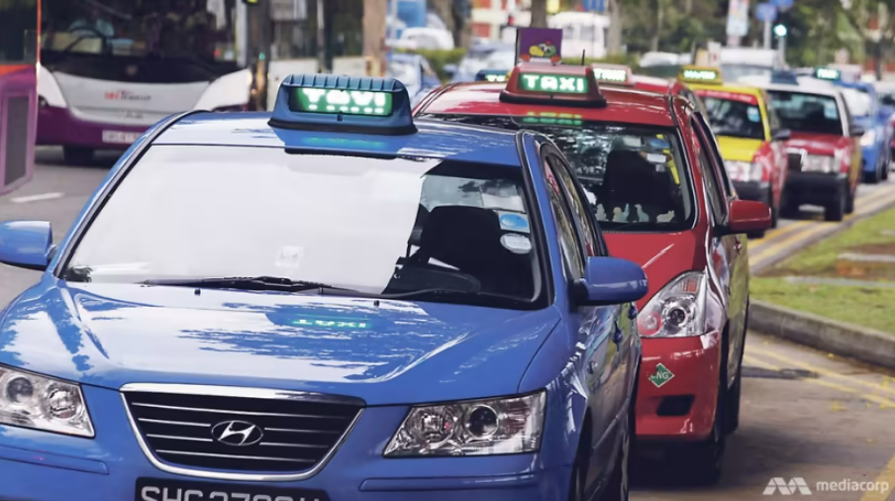
Problem Statement
Taxi drivers continue to grapple with falling incomes
Ever-rising overhead costs, competition
Lower passenger pick-ups
Commuters continue to deal with longer waiting times and higher price surges
Demand from local and tourists recovers
Certain areas are more affected
Notes:
Taxi drivers continue to grapple with falling incomes — amid ever-rising overhead costs, neverending competition from private-hire car services and lingering effects of the pandemic — the future of Singapore’s taxi industry has once again come under the spotlight.

Slide 5

Objectives
Improve and optimize taxi driver positioning through ML-driven prediction and recommendation system
Supply - Taxi Driver
Increase passenger pick-ups
Increase taxi drivers’ profits
Demand - Commuters
Reduce waiting times
Prevent price surges

Slide 6
02
Data Preparation
Data collection and cleaning

Slide 7
Data Sources
Public Crowds Volume
Taxi Availability
Potential taxi demand using public transport passenger volume
Data from LTA DataMall on Bus Stops and Train Stations passenger volume
Supply of taxi based on all available taxis for hire - exclude “Hired” or “Busy”
Data extracted from Data.gov.sg API

Slide 8
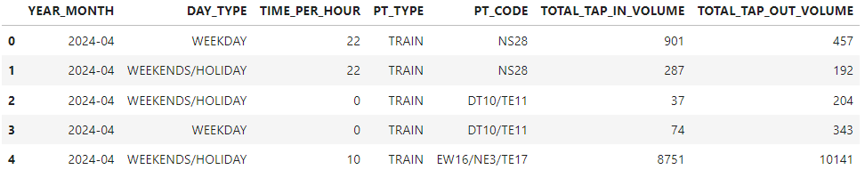
Public Transport Volume - Train
Hourly data for train passenger per month
Example, 12 = data is for 12:00 pm to 12:59
The total number of tap in and out of train stations
Example, for the entire weekday of Apr-2024, from 22:00 to 22:59, there are 901 tap-in and 457 tap-out at NS28 stations
2 types: weekday or weekend

Slide 9
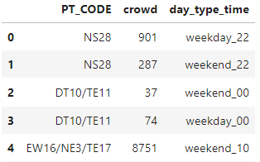
Public Transport Volume - Train
Data Processing:
Take the total passengers tap in volume as the crowd volume
Create new feature for day_type and time_per_hour combined

Slide 10
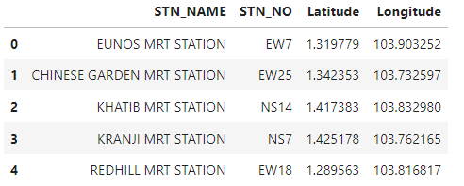
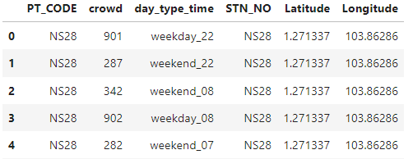
Public Transport Volume - Train
External data on train station latitude and longitude
Merge on train station code
Each train station is now represented by latitude and longitude

Slide 11
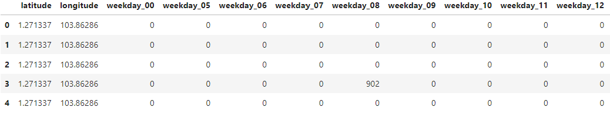
Public Transport Volume - Train
Dummify and multiply

Slide 12
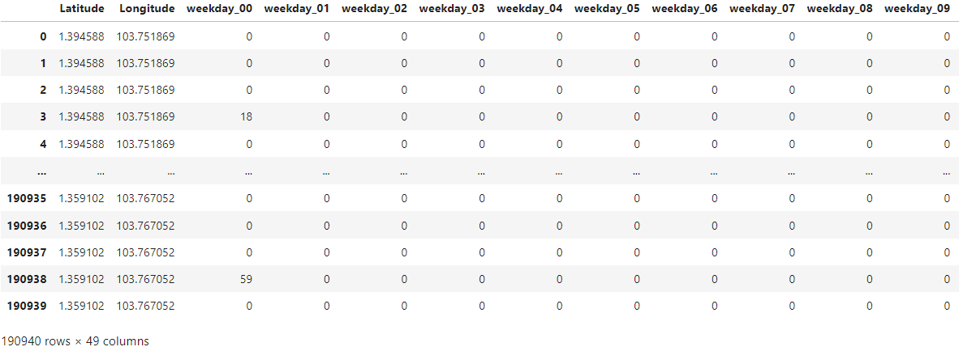
Public Transport Volume - Bus

Slide 13
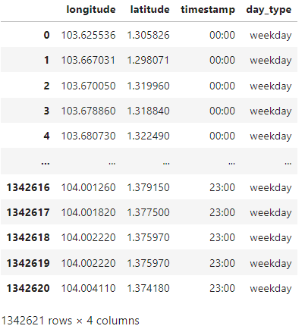
Taxi Availability
Processes:
Retrieve taxi availability from 01 to 30-Apr in an hourly format
Data extracted contains latitude and longitude of availability taxis at specific date and time
Convert the date and time into an hourly time format
Use datetime feature to determine if date is weekday or weekend

Slide 14
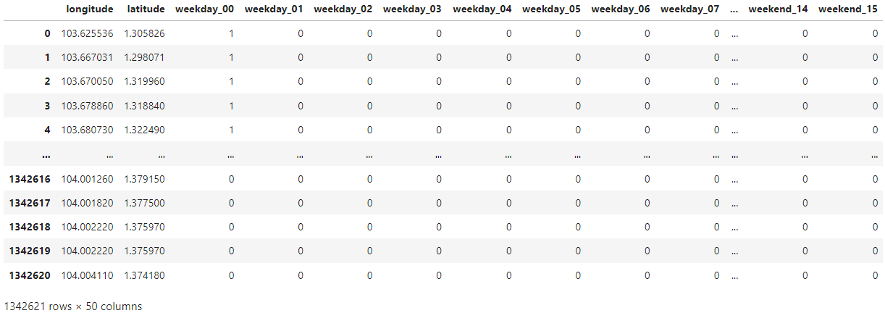
Taxi Availability
Combine the day_type and timestamp to form a “weekday_xx” format
Dummify and count

Slide 15
03
EDA
Data exploration, visualization, and preprocessing

Slide 16
Summary of Data
Demand - Public Crowds Volume
Supply - Taxi Availability

Slide 17

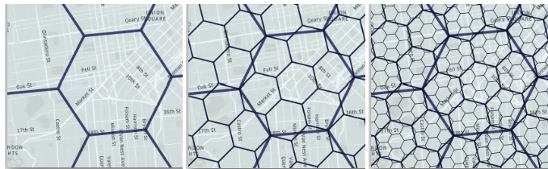

Uber H3 Spatial Indexing
Partitioning the Earth’s surface into hexagonal cells
Key Features
Grid system to bucket into hexagonal areas
Multiple levels of resolution, allowing representation at varying levels of details
Advantages
Simplify analysis - only one distance between a hexagon centerpoint to its neighbors’
Scalable analysis, enabling efficient zooming in and out

Slide 18
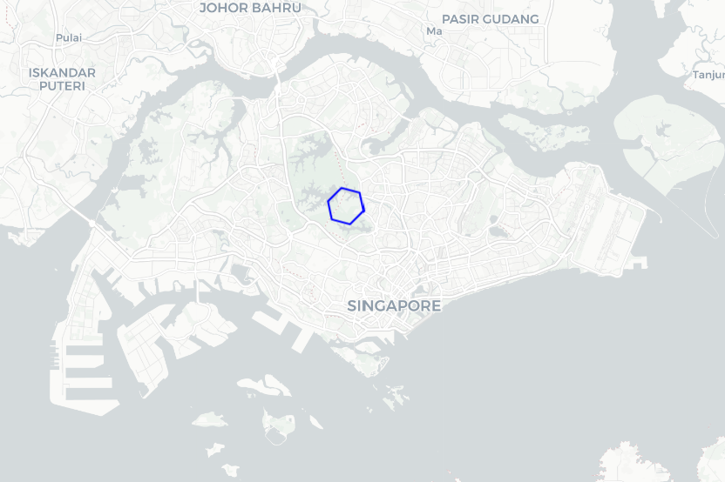
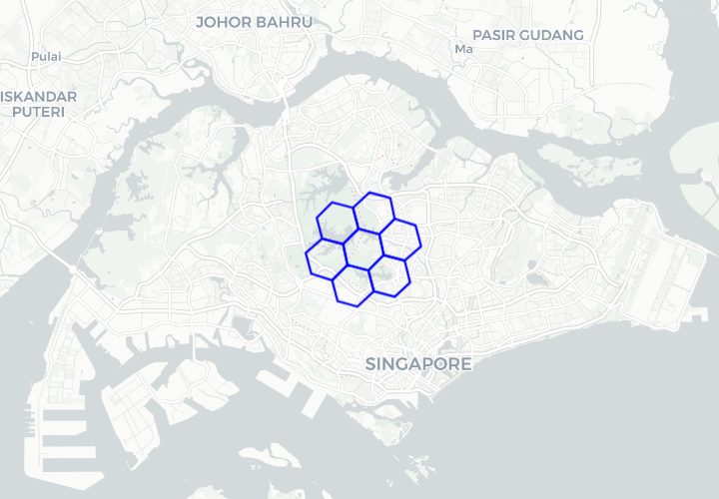
Initiate and Expand Hexagons
Initiate a hexagon from center of Singapore with resolution = 7
Expand the hexagon by 1 time, then continuously until it occupies the entire Singapore

Slide 19
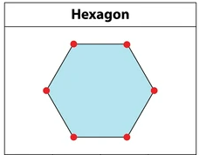
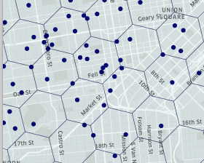
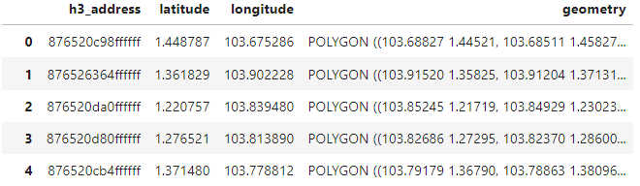
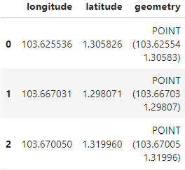
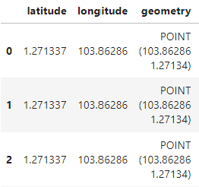
Crowds and Taxis Mapping
Hexagons - identify the vertices to determine the boundary
Crowds and Taxis - create a point coordinate feature

Slide 20
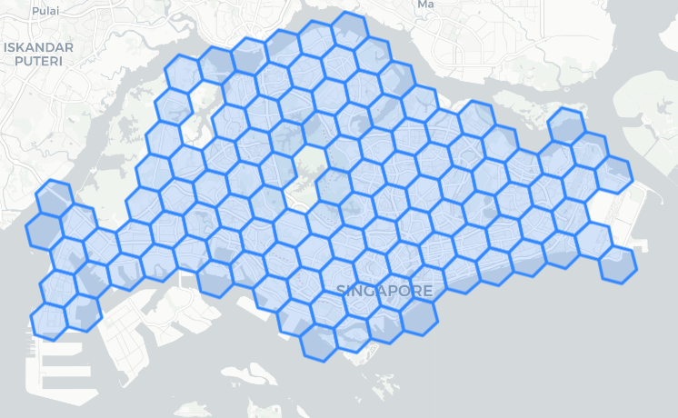
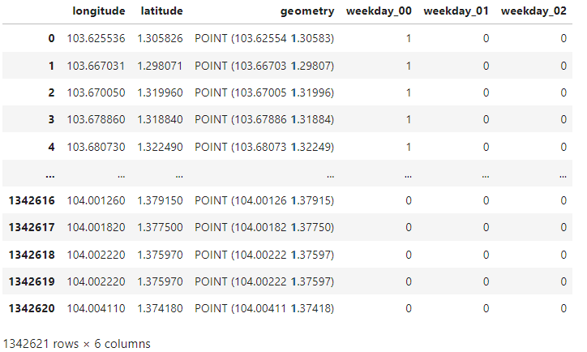
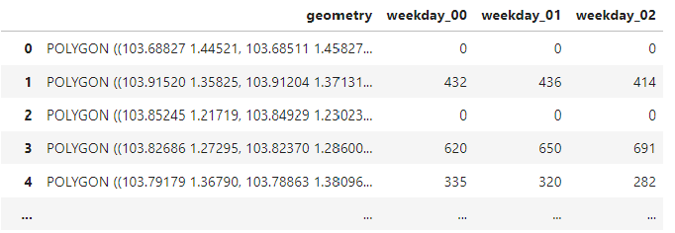
Crowds and Taxis Mapping
Locate at which hexagon each point is
Iterate through each taxis, bus, and train points
Count the number of points at each hexagon

Slide 21



Final Parameter
Number of trains and buses passengers and available taxis at each hexagon at different time (e.g. weekday_08, weekend_12)
Train
Bus
Taxis
Demand
Ratio
Supply
Demand
Supply

Slide 22
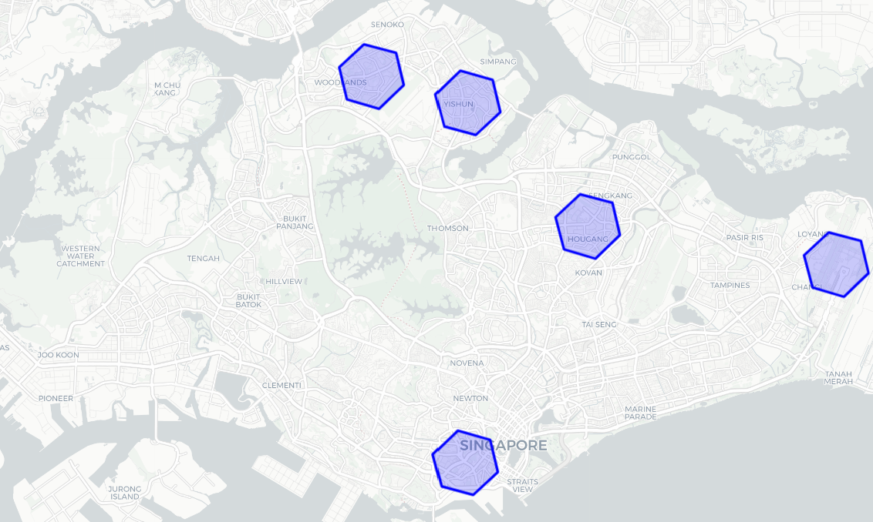
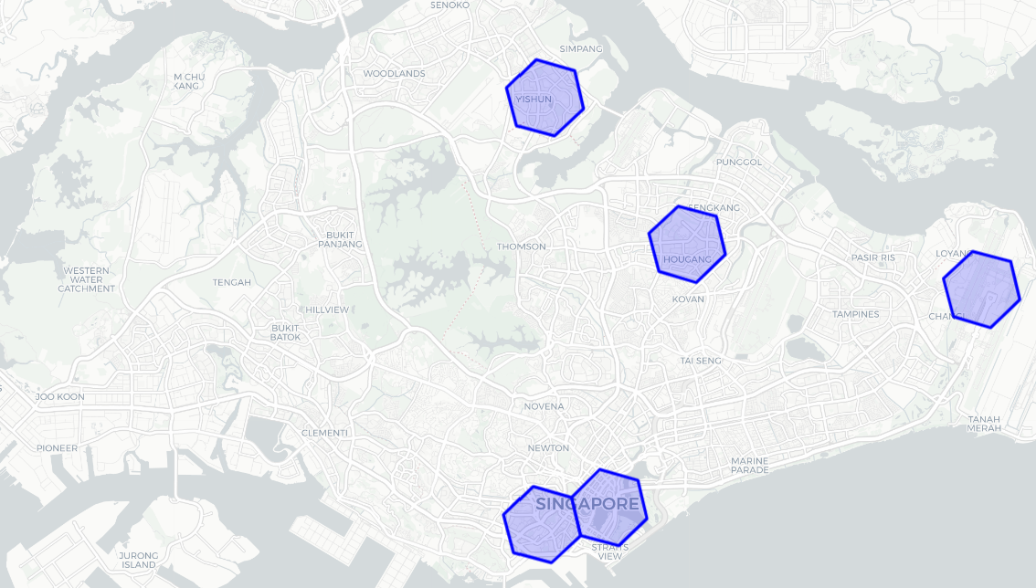
Taxi Availability
Top 5 areas with highest available taxis at the start and end of office hours
Weekday - 08:00
Weekday - 18:00
Woodlands, Yishun, Hougang, Tanjong Pagar, Changi
Yishun, Hougang, Tanjong Pagar, Marina Bay, Changi

Slide 23
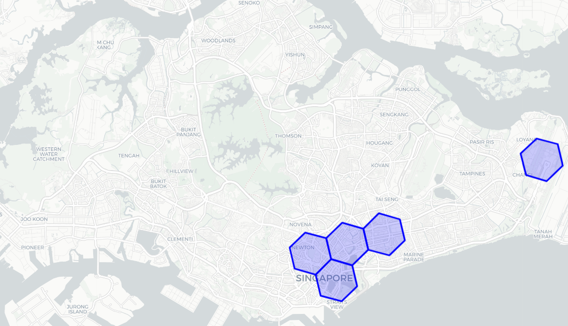
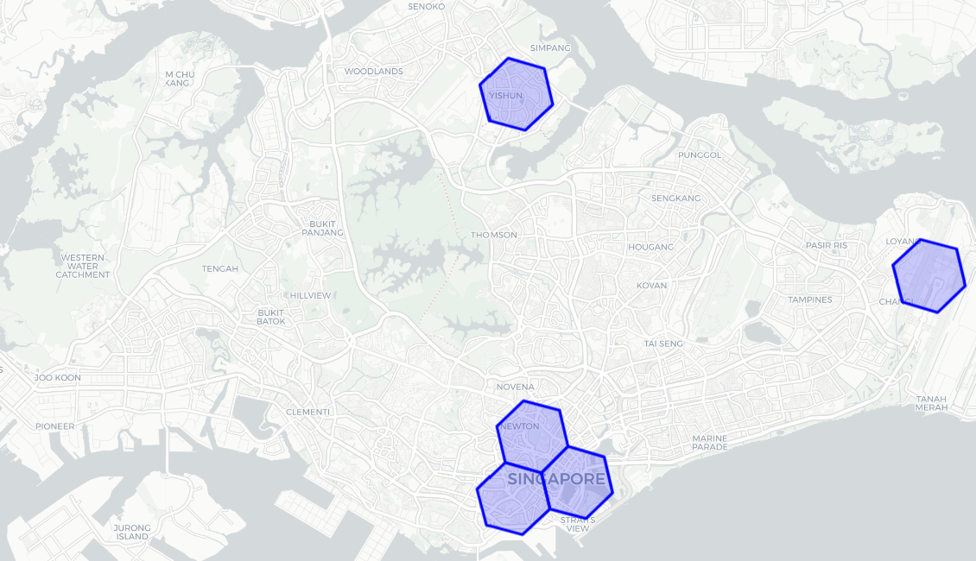
Taxi Availability
Top 5 areas with highest available taxis at weekend lunch and dinner time
Weekend - 11:00
Weekend - 18:00
Marina Bay, Newton, Bugis, Kallang, Changi
Yishun, Marina Bay, Bugis, Tanjong Pagar, Changi

Slide 24
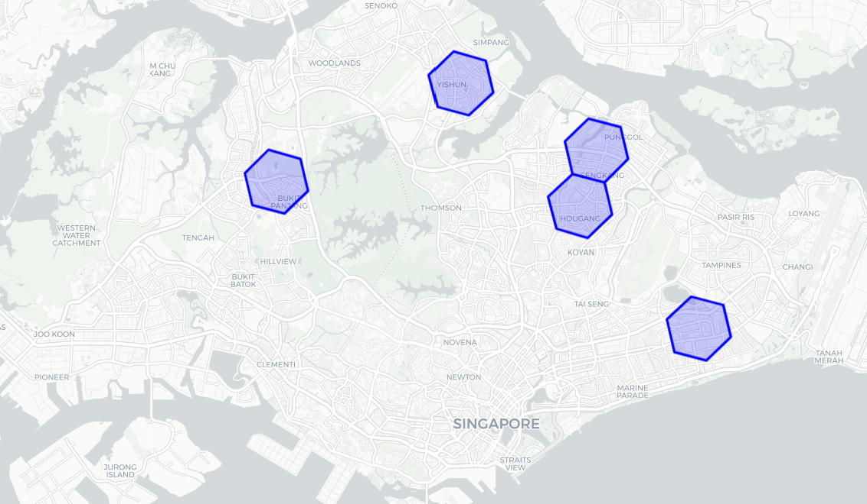
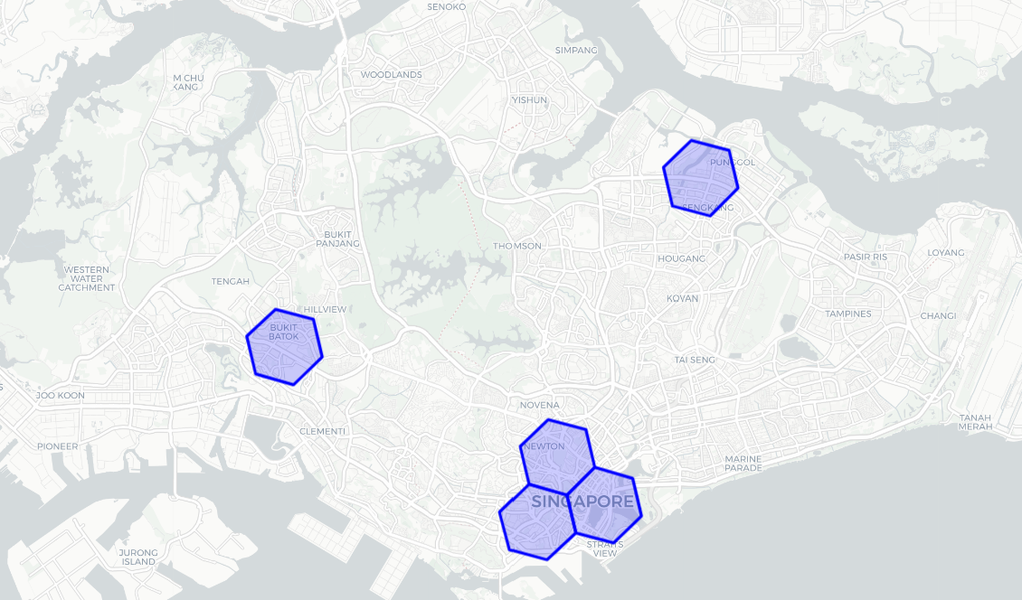
Passenger Volume
Top 5 areas with highest passenger volumes at the start and end of office hours
Weekday - 08:00
Weekday - 18:00
Bukit Panjang, Yishun, Sengkang, Hougang, Bedok
Jurong East, Sengkang, Tanjong Pagar, Bugis, Marina Bay

Slide 25
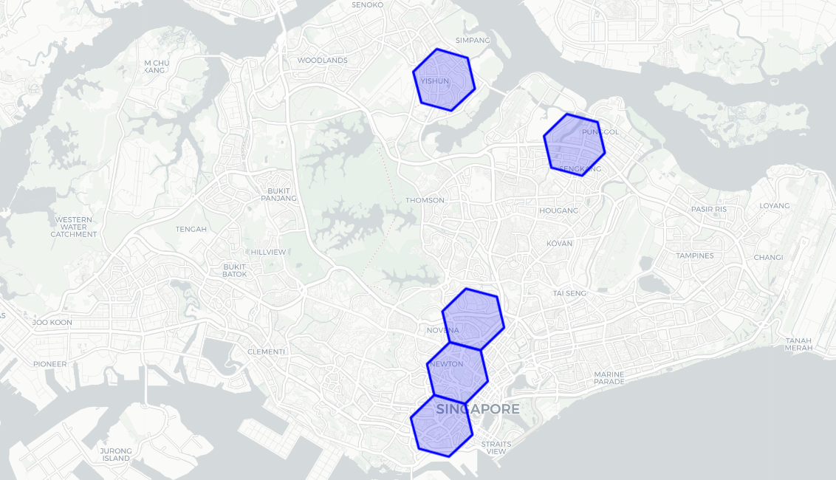
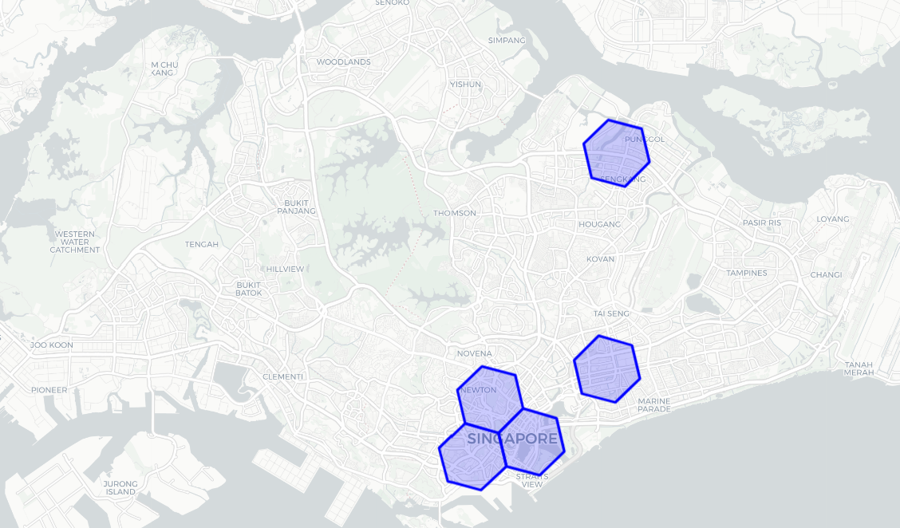
Passenger Volume
Top 5 areas with highest passenger volume at weekend lunch and dinner time
Weekend - 11:00
Weekend - 18:00
Yishun, Sengkang, Toa Payoh, Bugis, Tanjong Pagar
Sengkang, Tanjong Pagar, Bugis, Marina Bay, Kallang

Slide 26
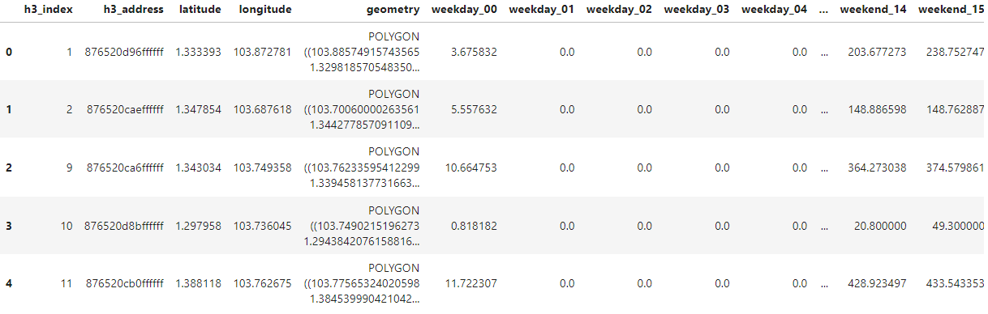
Data Preprocessing
1) Remove all irrelevant columns
2) Transpose to move the time frame into rows
3) Remove the 01 to 04 data as trains and buses are not in operation

Slide 27
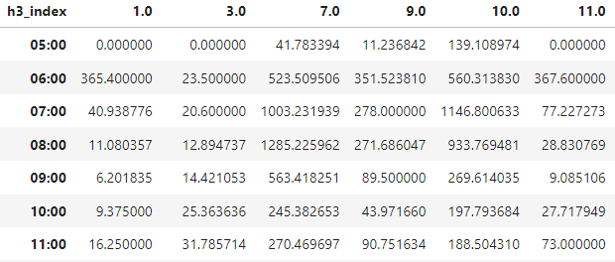
Data Preprocessing
Rows = All the time frame from weekday 00:00 to weekend 23:00
Columns = All the hexagons index
Data Value = Demand / Supply Ratio
38 time frame x 113 hexagons

Slide 28
04
Modeling
Time series modeling and performance evaluation

Slide 29

What are we modeling?
Generate a model to predict:
Demand / supply ratio for next hour, from 08:00 to 23:59 weekday and weekend
For all the hexagons
Rolling window approach with size = 3
38 time frame x 113 hexagons

Slide 30
Model and Metric
Model
Metric
Auto ARIMA - Baseline
Automate the optimal parameters
RNN - SimpleRNN
Neural network for sequential data
RNN - LSTM
Deal with long-term dependencies
Root Mean Squared Error (RMSE)
Evaluate the accuracy of model
Average magnitude of the errors between predicted vs actual values
Lower values = better model

Slide 31
Modeling Result
Auto ARIMA - Baseline = 143.74 RMSE
Model | RMSE
SimpleRNN - 32 units | 131.43
SimpleRNN - 50 units | 53.34
SimpleRNN - 128 units | 139.50
LSTM - 50 units | 130.76
RNN Components:
Sequential Model
Activation Function ReLU
Single output dense layer
ADAM optimizer

Slide 32
Evaluation
Best performing model is SimpleRNN with 50 units of layer
Why SimpleRNN with 50 units of layer performs better than those with 32 and 128 units?
50 units might provide the right balance between underfitting and overfitting
Moderate complexity of the data might align better with 50 units
Why SimpleRNN performs better than LSTM at the same 50 units of layer?
Data contains short-term patterns which gives SimpleRNN the advantage
Data is relatively simple
LSTM might result in overfitting when dealing with simple dataset

Slide 33
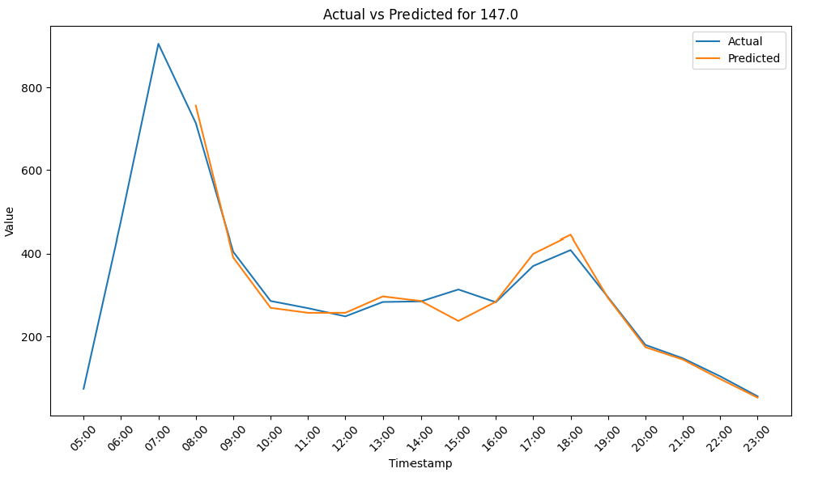
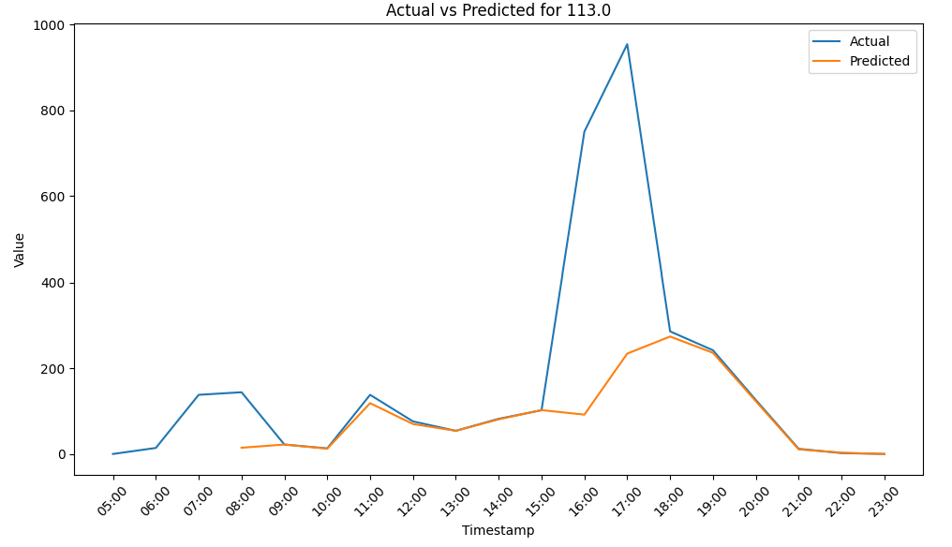


Evaluation
Majority of the trend shows predicted values match closely with actual
Example above the trend for hexagon no 147.0
In few cases, the model is unable to predict well when there is sudden spike in value
Likely due to the small window size of 3 timeframe

Slide 34

Next Step
Now that we have developed the model to predict taxis demand/supply ratio at different area,
how can we bring this to the taxi drivers?
Build RECOMMENDER SYSTEM

Slide 35
05
Recommender System
Recommendation system built from the developed model

Slide 36

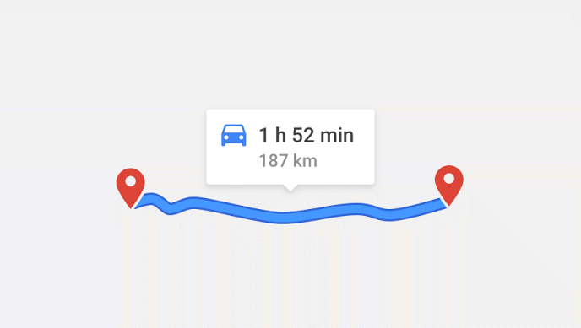
Three Features
Recommend the area to go for the next hour based on highest ratio
If now is 21:45, recommend for 22:00
Calculate the duration in traffic to the recommended area
Google Map Distance API
Provide the direction from origin to the recommended area
Google Map Direction API

Slide 37
Methodology
01
02
03
04
Calculate the time until the next hour
Generate prediction for the next hour
Iterate through the predicted values for all area
Recommend the area with highest ratio
08
07
06
05
Provide the direction to the destination
If not, provide the next highest ratio
Check if the time required is less than the time until next hour
Calculate the time required from origin to the recommended area

Slide 38
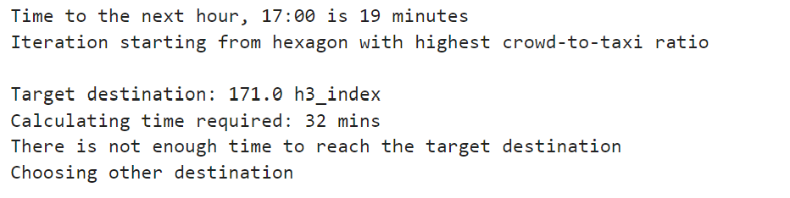
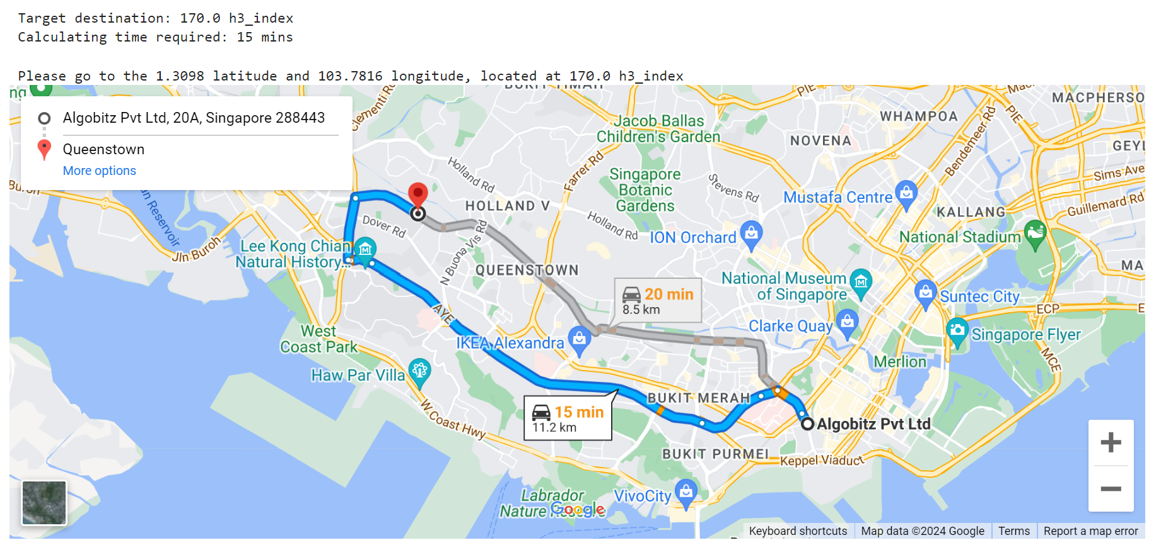
Recommender System
Scenario:
A taxi driver is driving at Tanjong Pagar area on a weekday at 16:41
He/she is looking where are the areas with high demand/supply ratio at 17:00 time frame within their reach

Slide 39

Now, let’s open Streamlit to view the app

Slide 40
06
Conclusion
Summary of project, limitation and future improvements

Slide 41
Summary
Objectives
Model
Improve and optimize taxi driver positioning through ML-driven prediction and recommendation system
Aim to benefit both taxi drivers and commuters
Build a model with SimpleRNN to predict taxi demand/supply ratio
Using the predicted values, build a recommender system to guide taxi drivers to the areas with highest ratio

Slide 42
Limitation and Improvement
Item | Limitation | Future Improvement
Public transport volume dataset | Data comes in the hourly format for weekday or weekend | More granular data in hour or minutes time frame
Inaccuracy of taxi demand | Taxi demand is based on public transport volume | Get the actual taxi demand based on the taxi pick up time
Limited application | Applicable to only taxi as it is the only open source data | Extend the concept to ride hailing services provided the demand and supply data are available

Slide 43
Thank you!

